Slide 1
A Level Computer Science
Tic Tac Toe using Pygame and a Stack

Slide 2
Introduction
This tutorial aims to help you develop a partially functioning Tic Toe Game that:
Displays a Graphical representation
Allows the user to select areas of a grid to place an icon/piece
Allows the user to undo a move using a stack (you have to build the stack yourself)

Slide 3
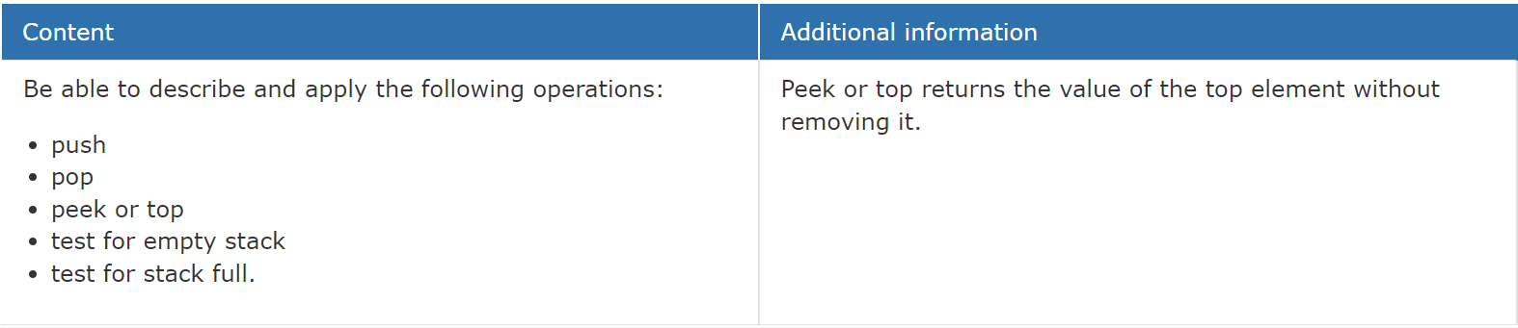
Stack
For this task you will have to create your own stack library

Slide 4
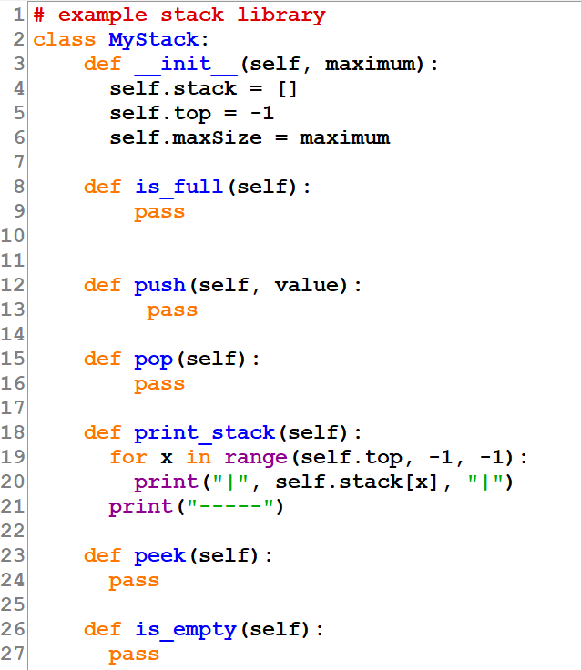
Stack Library
Stack Class
-Items: [ ] -top: integer
+push(item) +pop(): string [ ] +is_empty() +peek(): string [ ]

Slide 5
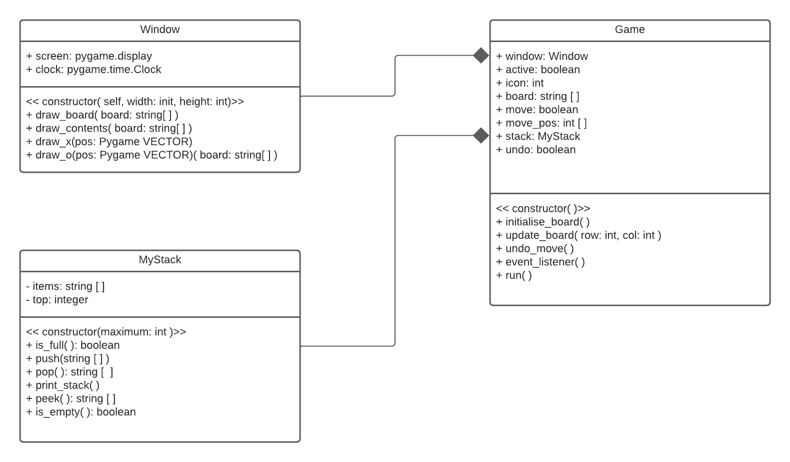
Game Structure Class Diagrams
Window Class handles all drawing to the screen.
Stack class keeps track of the board changes
Game Class runs the game and holds an instance of the window and stack class (Composition)

Slide 6

Python Files
This tutorial only uses two files. However, if this was a more complex project the Window class could reside it its own file as an external library.

Slide 7
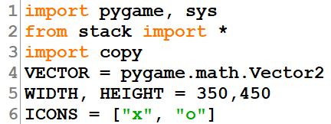
Main.py
There are a few libraries that need to be imported for this project:
Pygame – used to render the tic tac toe board and icons
Sys – used to allow the window/program to end when window is closed
Stack – the OOP implementation of a stack for storing board states after every move.
Copy –used to create a deep copy of the board (an array) so the copy is an entirely different array stored in a different memory address
There are a few global constants we want to refer to throughout the project
VECTOR – used to create a vector datatype from the pygame library without having to use the long name for reference
WIDTH and HEIGHT – dimensions for the screen
ICONS – the icons for use in TIC TAC TOE

Slide 8
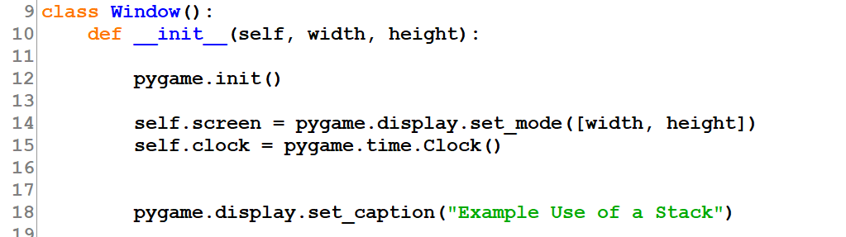
Window Class
The constructor for the window class initialize a pygame window and displays the caption in the window frame. The constructor expects to receive values for width and height to be stored as parameters.

Slide 9
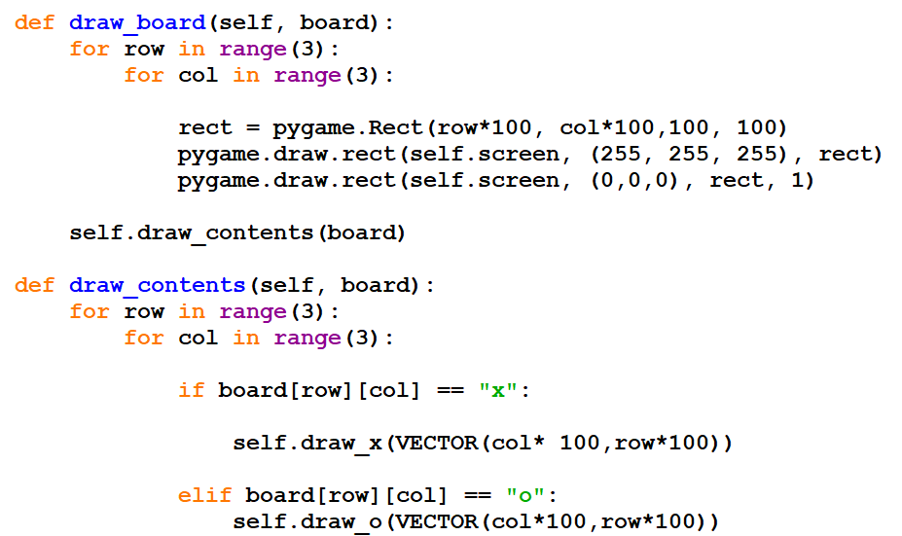
Window Class
The draw_board method creates a grid of squares (100 pixels by 100 pixels. Each square is white and drawn on top of it is an outline an empty square with a black outline (creates the grid lines)
The draw_contents method, iterates through the board (2D array) checking each element for either an “x” or an “o”. When either is encountered, the relevant method is called to draw the icon.

Slide 10
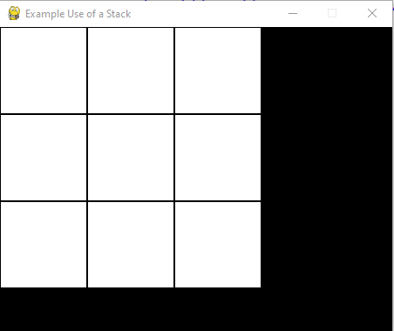
Positions within the grid
A pygame window has the origin in the top left and has an inverted y axis.
Each grid cell is 300 by 300 pixels
origin
(0,0)
X = 300
Y = 0
X = 300
Y = 300
X = 0, Y = 300

Slide 11
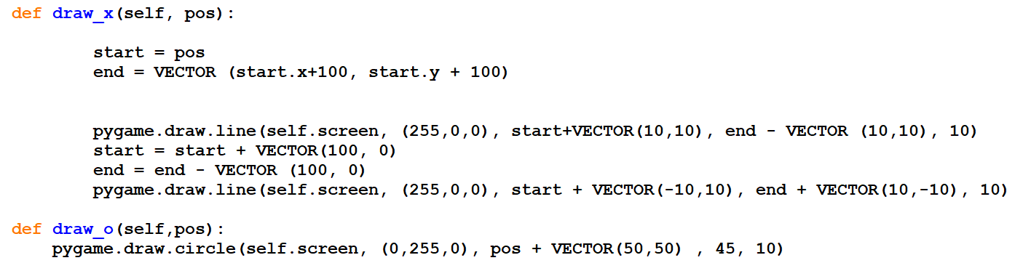
Window Class
draw_x uses two lines to represent the “X”. The method accepts a VECTOR datatype and through vector addition the start and end position of each line are manipulated so they are within the square instead of being on the actual square border of the cell being drawn in.
draw_o again accepts a pos of VECTOR datatype which represents the top left corner of the current cell and through vector addition the circle is drawn at the center of the cell with a radius of 45 and line thickness of 10

Slide 12
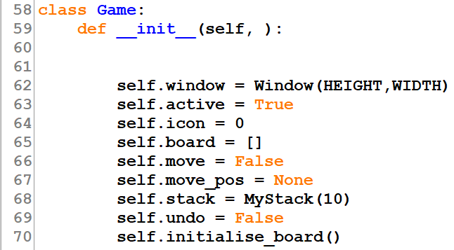
Game Class
The Game class constructor creates several attributes:
window – an instance of the Window class
active – used for the main game loop
icon – index of the current icon in play from the global constant array
board – a 2D array representing the board
move – a Boolean value representing whether a successful move has been made
move_pos – will be of type VECTOR and represents the screen positon of the cell that has been chosen to make a move to
stack – and instance of the class MyStack
undo – a Boolean value representing whether the user has chosen to undo a move
Finally the constructor calls the class method to initialize a game board,

Slide 13
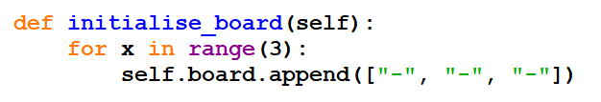
Game Class
The initialize board method simply create a 2D array (3 by 3) representing the Tic Tac Toe grid.

Slide 14
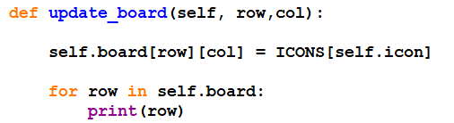
Game Class
The update_board( ) method receives parameter values for the row and column in the 2D array where we want to make a change.
We update the correct element with the current icon (x or o) in play.
We then display the updated version of the board

Slide 15
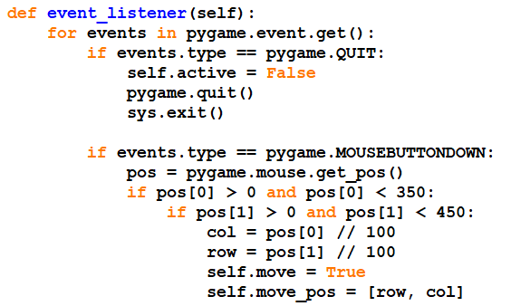
Game Class
Within the game loop, we constantly listen for user interactions, i.e, a mouse button click. If they press the close window button we need to and the application so we use the method pygame.quit() to close the wndow and sys.exit() to end the program.

Slide 16
Game Class
If the user clicks on the screen and the x coordinate is between 0 and 350 and the y coordinate is between – and 450 we know they have click within the active area of the screen.

Slide 17
Game Class
origin
(0,0)
X = 300
Y = 0
Assuming the user clicks within the grid on screen we can calculate the row and col index by dividing by 100
X = 300
Y = 300
X = 0, Y = 300

Slide 18

Problem
If the user clicks outside the grid we get the following error:
The division has led to an index that is not possible in the 2D array.
Can you think of a way to fix this?

Slide 19
Game Class
The last section here sets the move attribute to True, which lets the game know a move has taken place.
The intended move position is stored as an array

Slide 20
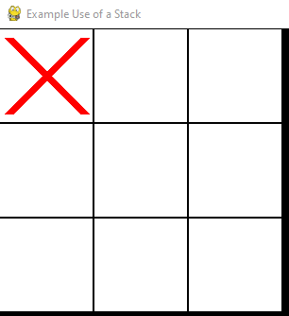
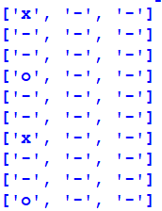
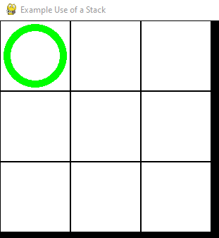
Problem
By continually selecting the same gird square we can overwrite the previous change.
Can you think of a way to fix this?

Slide 21
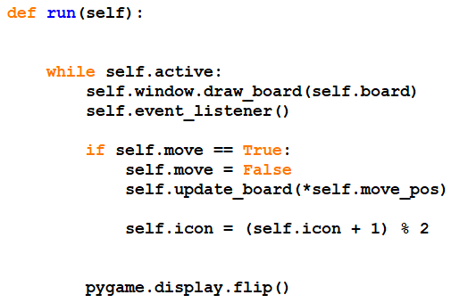
Game Class
The run method ( ) creates and runs the game loop.
The game loop starts with drawing the board onto the screen by called he the appropriate method for the window class.
Following drawing the board the event_listener( ) method is called to check if the user had interacted in someway (mouse or keyboard use).

Slide 22
Game Class
If the move attribute is flagged as True then we have a move process. The attribute is immediately set back to false for the next iteration of the game loop.
The game board is then updated the row, col position of the 2D array element is passed as an argument.
The icon attribute is then updated to the next index. By using MOD 2 it will always restrict the values to being 0 or 1 and change in a cycle.
(0 + 1) MOD 2 = 1 (how many 2s go into 1, 0 remainder 1 )
(1 + 1) MOD 2 = 0 (how many 2s go into 2, 2 remainder 0 )
Finally we update the display with any changes. Pygame essentially uses 2 screens. You draw any changes on the screen behind and then when updating you flip the screen.

Slide 23
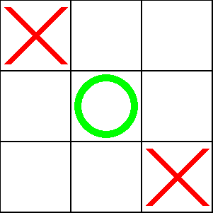
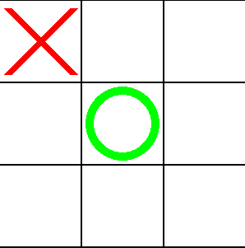
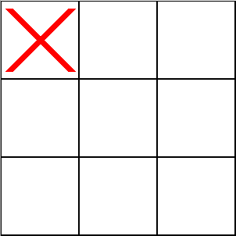
Using the Stack to undo
Each stack frame will store a copy of the board.
3
2
1

Slide 24
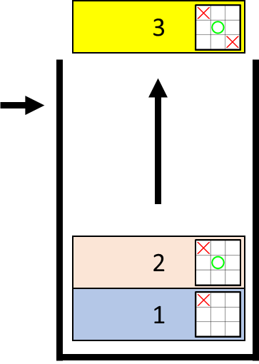
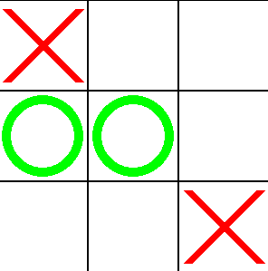
Using the Stack to undo
Current board =
Current board =
1. The move the user wants to undo
3. Assign the frame to the current board
2. Pop the last frame from the stack
If we want to undo a move, we pop a frame (copy of board) off the top of the stack and assign this to the current board

Slide 25
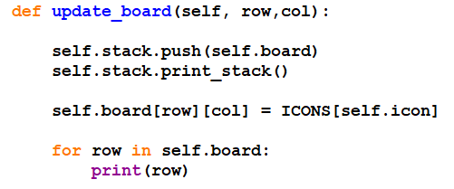
Using the Stack to undo
When we select a cell and change the board we need to push a copy of it onto the stack.
Displaying the stack will show a problem here

Slide 26
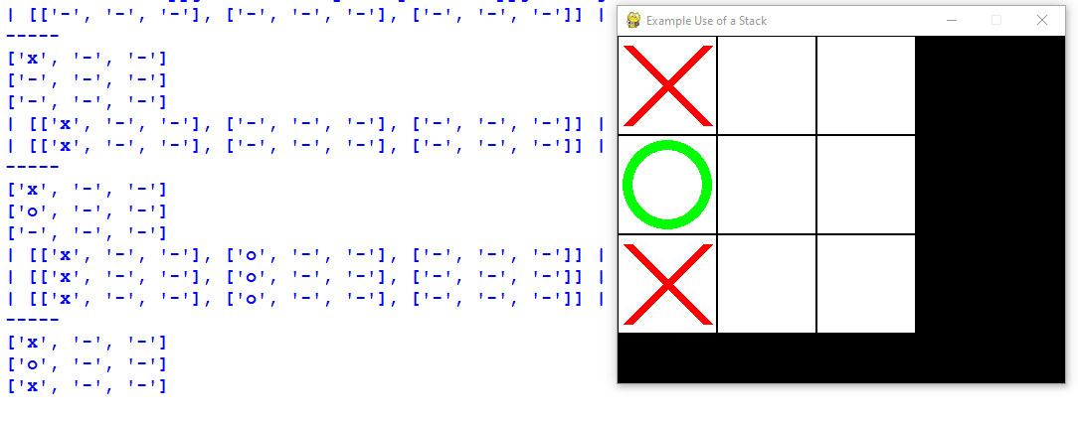
Problem
Because arrays/lists pass by reference we are passing the memory location and not the value to the stack. This results in each stack frame having the same array

Slide 27
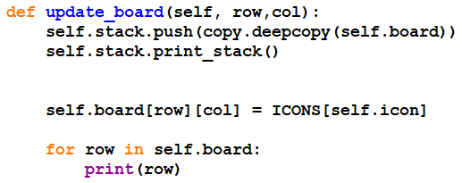
Solution
The solution is to create a deep copy of the array.
This results in an entirely new array stored at a different memory address.

Slide 28
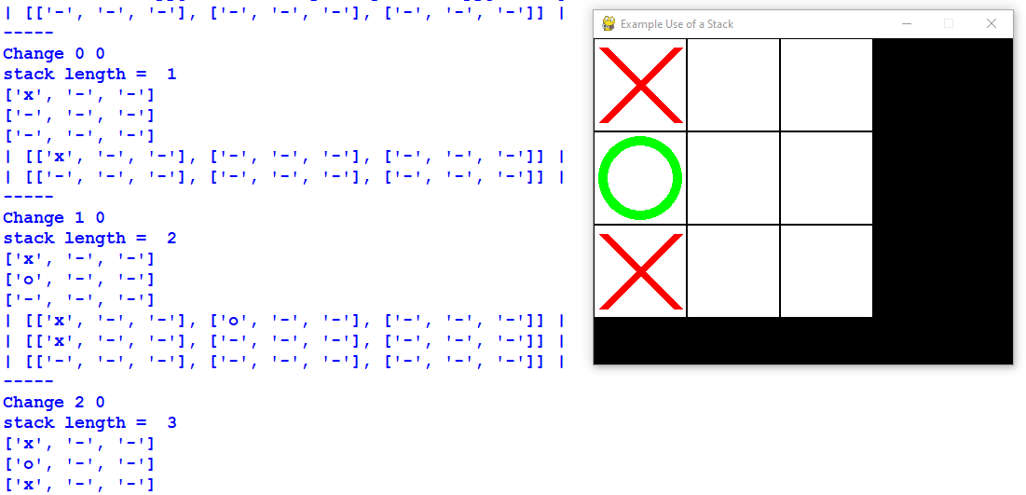
Solution
Now, you can see as the stack grows the contents in each frame differ

Slide 29

Using the Stack to undo
The next step is to give the user some way of signalling they want to undo a move.
Adding a new event to check for in the events loop of the events_listener( ). When the user presses the ‘u’ key, the flag variable undo is set to True.

Slide 30
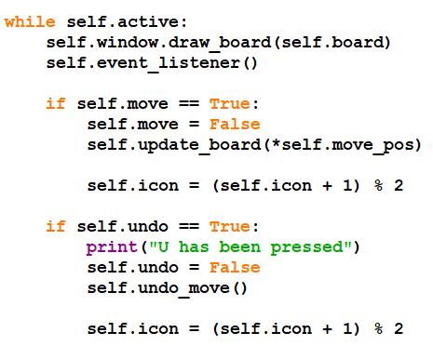
Using the Stack to undo
Within the game loop (run method) a check is made on the flag variable undo. If it has been set to True, it is immediately reset to False. The method undo_move( ) is called to action change the board and the icon is updated as before to point to the other icon.

Slide 31
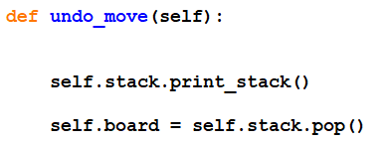
Using the Stack to undo
The board can simply be updated by calling the stacks pop method which removes the frame from the top of the stack and assigns it to the board.
Current board =
1. Pop the last frame from the stack
2. Assign the frame to the current board

Slide 32
Improvements
[1] Write a method (Game Class) called check_win( ) that is called within the game loop after move has been made but before the current icon is updated. The method will accept as a parameter the current icon/piece and search through the 2D array to check for a winner.
https://leetcode.com/problems/find-winner-on-a-tic-tac-toe-game/

Slide 33
Improvements
[2] Add a button for the undo action. To do this you will need to research how to create buttons in pygame

